Slide 1







CORONA VIRUS ANALYSIS
Data Analysis using MySQL
By Oluwatosin Joshua Adebayo

Slide 2





Data shows that the United States has the highest number of confirmed cases (33,461,982) followed by India, Brazil and Turkey while Dominica, Kiribati, Marshall Islands and Samoa recorded zero deaths and the United States has the highest deaths (599,769) followed by Brazil and India during the period under review.
Executive Summary
As the virus spreads, various countries experienced spike in the number of cases monthly because widespread information and detecting process were not fully known at the time with uncontrolled movement which made the virus endemic locally and pandemic globally affecting all areas of human existence.

Slide 3



Contents
01
02
03
Introduction
Objectives (Problem Statement)
Data Overview
04
05
06
Data
Explanation
Exploration &
Key Insights
Conclusion

Slide 4


Introduction
01
According to *WHO, coronavirus disease 2019 (COVID-19) pandemic is a global outbreak of coronavirus – an infectious disease caused by the severe acute respiratory syndrome coronavirus 2 (SARS-CoV-2)
COVID-19 symptoms ranges from asymptomatic to deadly, but most commonly include fever, sore throat, nocturnal cough, and fatigue.
Transmission of the virus is often through airborne particles.
*WHO - World Health Organisation

Slide 5




1
We have been tasked with analyzing CORONA VIRUS dataset to derive meaningful insights.
Objectives/
Problem
Statement
The CORONA VIRUS pandemic has had a significant impact on public health and has created an urgent need for data-driven insights to understand the spread of the virus.
Using SQL to show the key insights of the spread during the year under review (2020 -2021).
2
Presenting the analysis findings.
Tool used for analysis is MySQL workbench
3
02

Slide 6

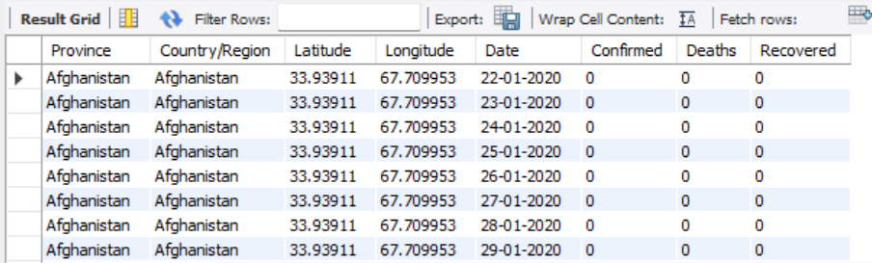
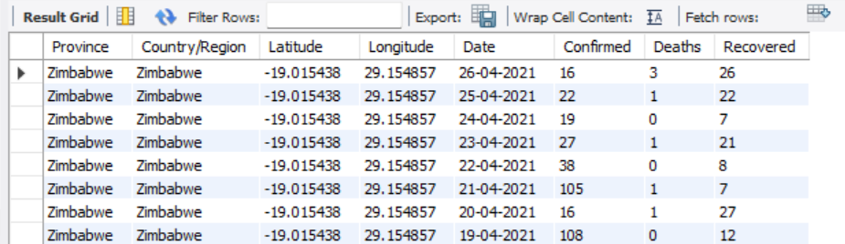
Data Overview
03
This dataset contains records of confirmed cases, deaths and recovered cases across the globe which runs from 2020 -2021.

Slide 7

Data Explanation
04
Description of each column in dataset:
Province: Geographic subdivision within a country/region.
Country/Region: Geographic entity where data is recorded.
Latitude: North-south position on Earth's surface.
Longitude: East-west position on Earth's surface.
Date: Recorded date of CORONA VIRUS data.
Confirmed: Number of diagnosed CORONA VIRUS cases.
Deaths: Number of CORONA VIRUS related deaths.
Recovered: Number of recovered CORONA VIRUS cases.

Slide 8

05
DATA EXPLORATION
&
KEY INSIGHTS
All analysis were done using SQL (MySQL)
to gain insights on the data.

Slide 9

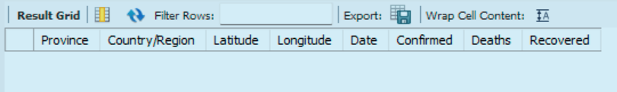
05
To avoid any errors, checks for missing / null values was first carried out.
No missing or null values and it requires no update statement to replace all nulls with zero.

Slide 10
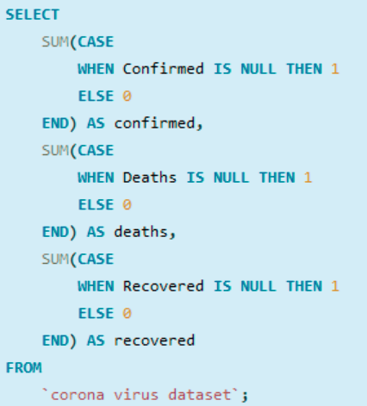
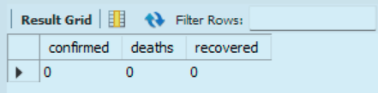
05
Putting it into perspective
Using Case statement, it made it clear that there are no null values hence it returned zero.

Slide 11
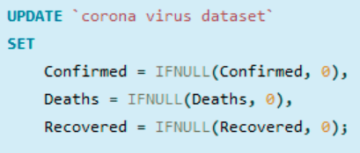
05
For knowledge purposes, this query will help update null or missing values with zero.

Slide 12
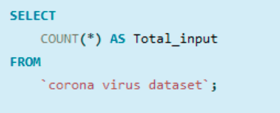
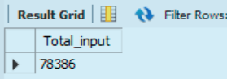
05
The number of rows this dataset covers

Slide 13
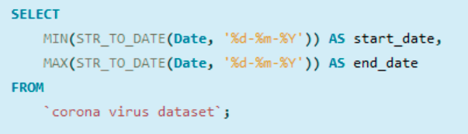
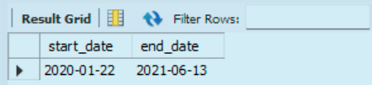
05
The start_date and end_date this dataset covers

Slide 14
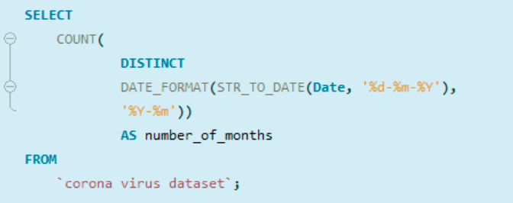
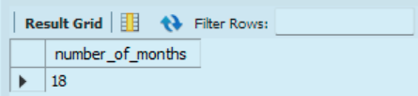
05
The Number of month this dataset covers

Slide 15
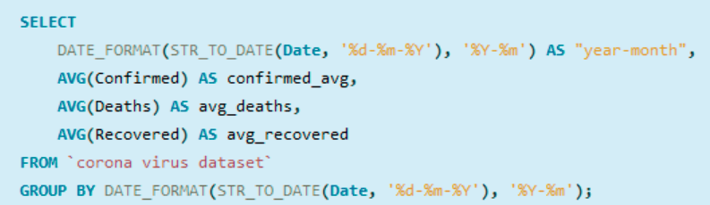
05
The monthly average for confirmed, deaths and recovered cases

Slide 16
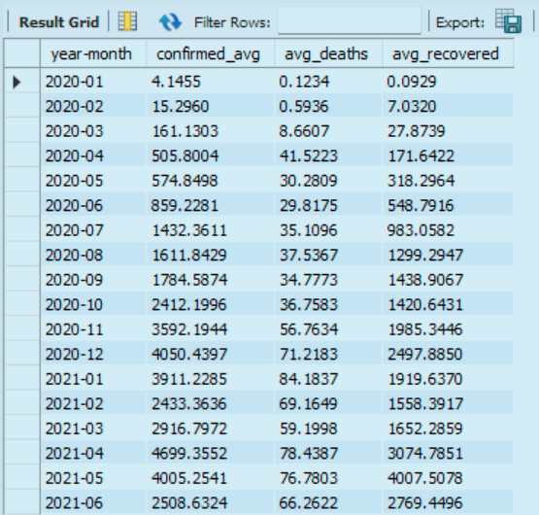
05
The monthly average for confirmed, deaths and recovered cases

Slide 17
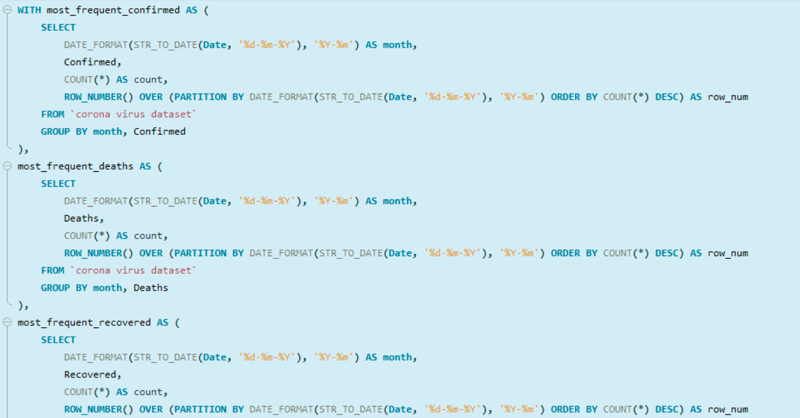
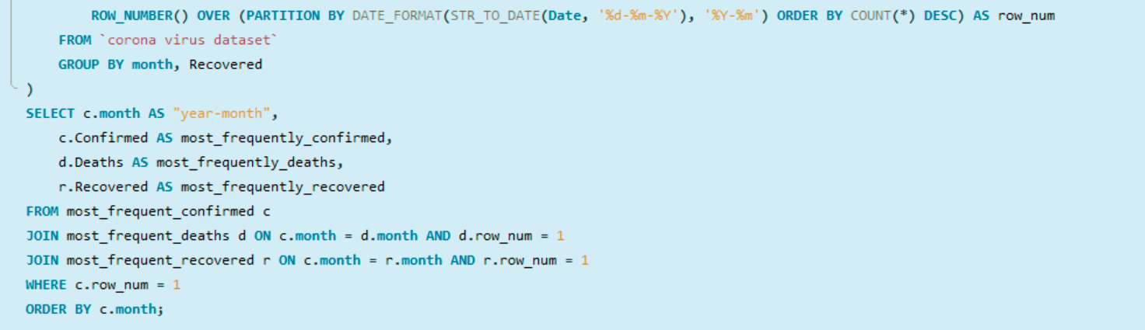
05
The most frequent value (mode) for confirmed, deaths, recovered cases each month.

Slide 18
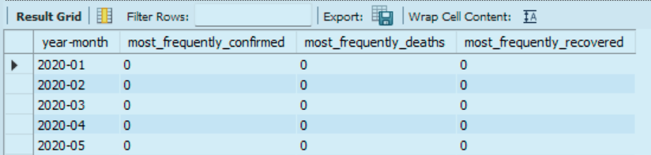
05
The most frequent value (mode) for confirmed, deaths, recovered cases each month.

Slide 19
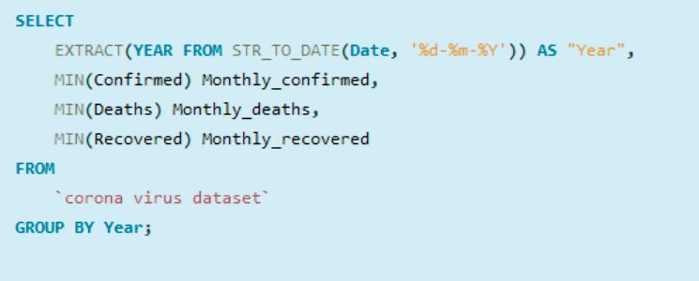
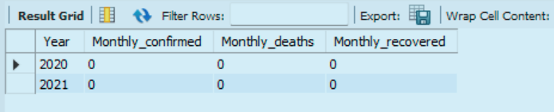
05
The minimum values for confirmed, deaths, recovered cases per year.

Slide 20
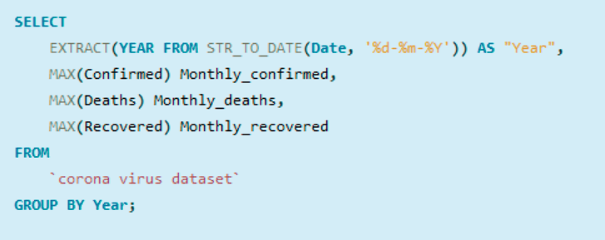
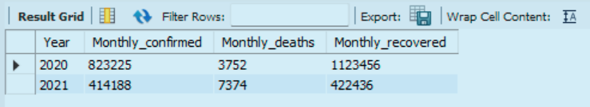
05
The maximum values for confirmed, deaths, recovered cases per year.

Slide 21
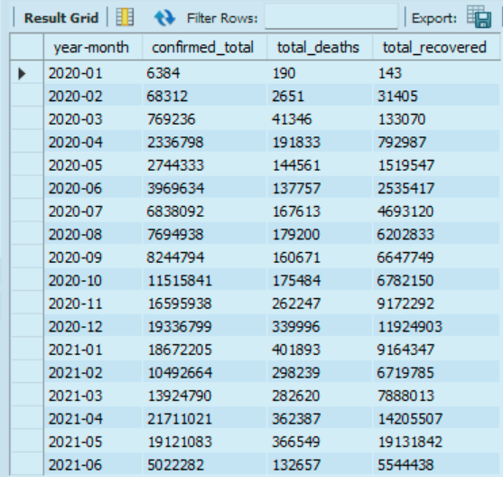
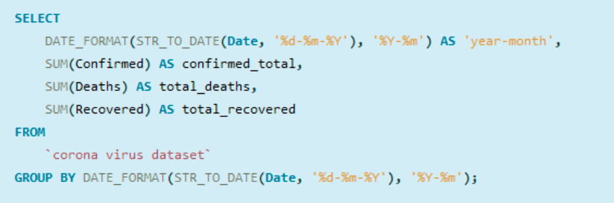
05
The total number of confirmed, deaths, recovered cases each month

Slide 22
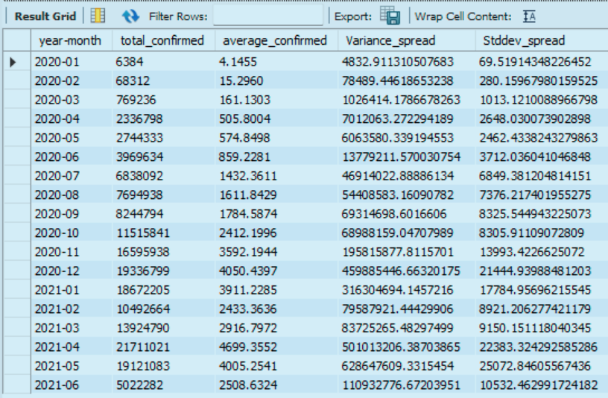
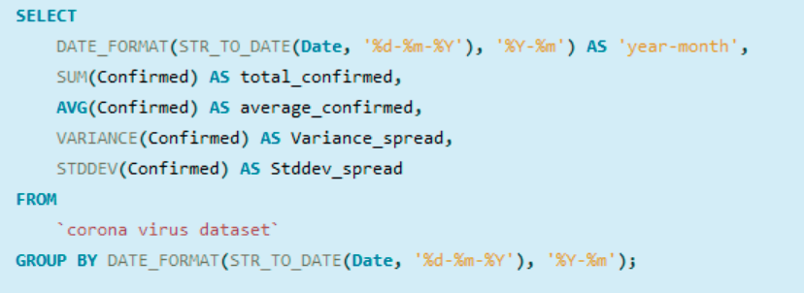
05
How corona virus spread out with respect to confirmed cases.

Slide 23
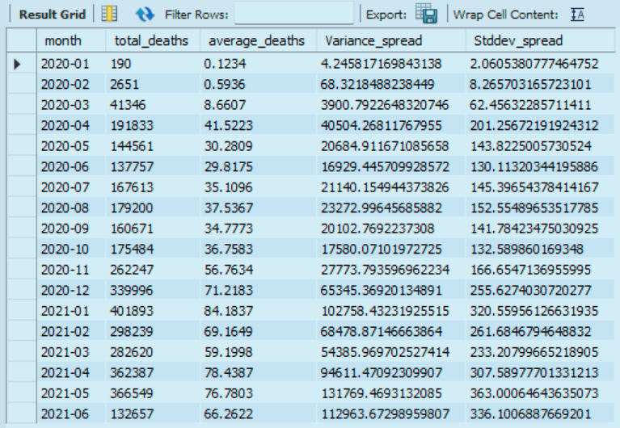
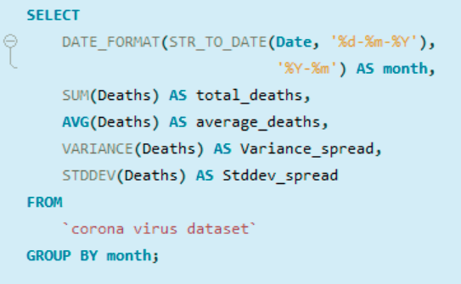
05
How does corona virus spread out with respect to death case per month.

Slide 24
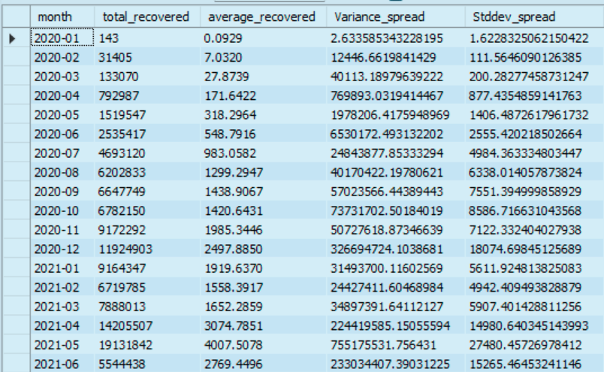
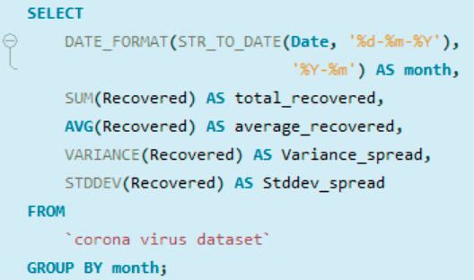
05
How corona virus spread out with respect to recovered case.

Slide 25
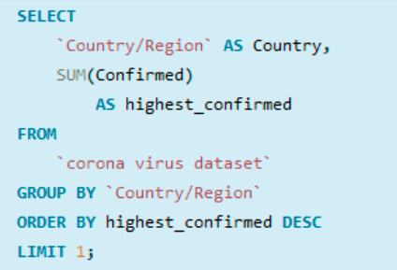
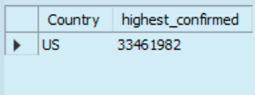
05
Country having highest number of confirmed case

Slide 26
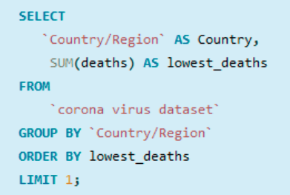
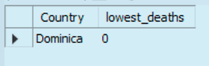
05
Country having the lowest number of the death case

Slide 27
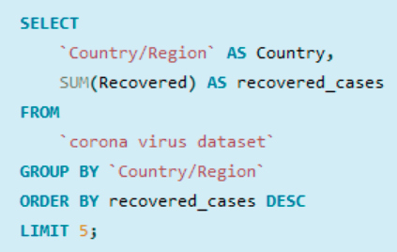
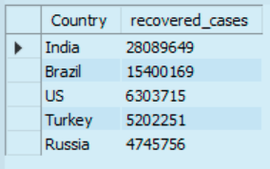
05
Top 5 countries having highest recovered cases

Slide 28
05
Actionable Insights
As the widespread and confirmed cases grew, this showed the unpreparedness of many countries in combating widespread of infectious diseases.
With the advent of COVID-19, it is a wake up call to every countries to step us vast research and contribute to existing knowledge, accurate procedures in combating and curtailing widespread of viruses and diseases outbreak.

Slide 29
06
Conclusion
During the period under review, the United States of America, India, Brazil amongst other countries that encountered sudden spike in COVID cases can be attributed to; continuous clustering of people was a contributing factor as movement of people were not put on hold early enough.

Slide 30



THANK YOU!
ayojoshua01@gmail.com

